Slide 1

DEPARTMENT OF COMPUTER SCIENCE AND ENGINEERING (Networks)
6CSN MINI PROJECTS FOR THE ACADEMIC YEAR 2023-24
MiniProject Presentation on
LOCATIONLENS: GEO-TAGGED PHOTO ANALYSIS FOR INSIGHTS
Presentation Date: 23-Jan-2024.
MiniProject Supervisor:
Presented by:
Dr. S. Narasimha Reddy
Associate Professor
B21CN005
P. Sarayu

Slide 2
ABSTRACT
Geotagging, the process of associating geographical information with various forms of media, has become increasingly prevalent in today's digital landscape. This presentation aims to provide a comprehensive overview of geotagging, exploring its applications, methodologies, and implications.

Slide 3

OBJECTIVES
Helps to identify where activities or content are taking place.
Improves user experience with wayfinding and navigation.
Promotes accessibility, group, and classify content according to its geographical location.
Encourages individualized experiences, regulatory compliance, and emergency response

Slide 4
METHODOLOGY
Set camera to GPS time
Turn on GPS recorder
Click pictures
Download tracker data to GPX
No
Shooting with RAW files?
Edit EXIF data
Yes
Save files in JPEG format
Edit files in RAW format
Upload the picture

Slide 5
SOFTWARE REQUIREMENTS
Exiftool
Language: Python
Web Framework: Flask

Slide 6

TOOLS
Manual Geotagging.
Automatic Geotagging using a built-in GPS
Automatic Geotagging using a connected GPS
.

Slide 7
MERITS
Photography and social media
Navigation mapping
Environmental planning
Geo-tagged advertising and monitoring

Slide 8
DEMERITS
Privacy risks
Location spoofing
Battery drain
Location-based advertising intrusiveness

Slide 9
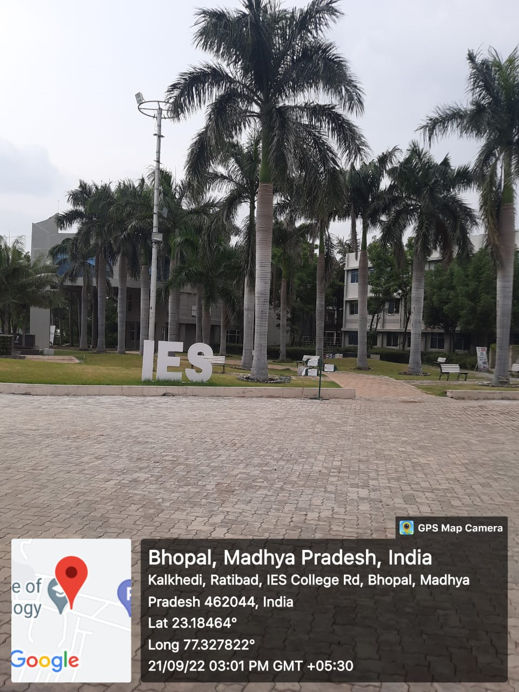
EXPECTED OUTCOME

Slide 10
CONCLUSION
To sum up, geotagging has become a crucial component of contemporary technology, with a wide range of uses in various sectors. The way we interact with information and engage with our surroundings has changed dramatically as a result of the capacity to add spatial information to data, including images and other content. Geotagging gives data important spatial context and is useful for a variety of purposes, including improving social media experiences, navigation, aiding emergency services, and assisting environmental study.

Slide 11
REFERENCES
[1] L. Hollenstein and R. Purves, ‘‘Exploring place through user-generated content: Using Flickr tags to describe city cores,’’ J. Spatial Inf. Sci., vol. 1, pp. 21–48, Jul. 2010.
[2] J. Chen and S. L. Shaw, ‘‘Representing the spatial extent of places based on Flickr photos with a representativeness-weighted kernel density estimation,’’ in Proc. Annu. Int. Conf. Geographic Inf. Sci. Cham, Switzerland: Springer, 2016, pp. 130–144.
[3] J. K. Parker and J. A. Downs, ‘‘Footprint generation using fuzzy neighborhood clustering,’’ GeoInformatica, vol. 17, no. 2, pp. 285–299, Apr. 2013.
[4] H. Alani, C. B. Jones, and D. Tudhope, ‘‘Voronoi-based region approximation for geographical information retrieval with gazetteers,’’ Int. J. Geographical Inf. Sci., vol. 15, no. 4, pp. 287–306, Jun. 2001.
[5] M. J. Somodevilla and F. E. Petry, ‘‘Fuzzy minimum bounding rectangles,’’ in Spatio-Temporal Databases. Cham, Switzerland: Springer, 2004, pp. 237–263

Slide 12
THANK YOU

